Slide 1
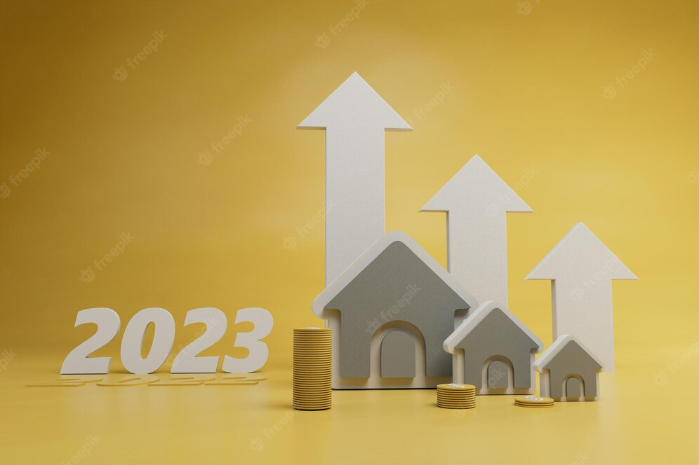
Chennai House Price Prediction
By:
Hariprasath S

Slide 2
OUTLINE
Abstract
Problem Statement
Project Specification
Dataset Description
Pipeline
Data Mining
Data Cleaning
EXPLORATORY DATA ANALYSIS
DATA VISUALIZATION
MODEL EVALUATION
K-fold cross validation
Result/Output
Drawback

Slide 3
ABSTRACT
We developed a machine learning model to predict house prices in an Indian city for this project (Chennai).
This project will be extremely beneficial to the real estate market.
Our model is applicable to both home sellers and home buyers.
Chennai house sale price data is shared here and the participants are expected to build a sale price prediction model.

Slide 4
PROBLEM STATEMENT
Real estate transactions can be quite opaque at times, making it challenging for first-time buyers to determine the fair market value of any given home.
Several real estate websites can predict house prices based on a variety of factors.
Chennai house sale price data is shared here, and participants are expected to create a sale price prediction model that will help customers find a fair price for their homes while also assisting sellers in understanding what factors are fetching more money for their houses.
help sellers in understanding what factors are bringing in more money for their homes?

Slide 5
PROJECT SPECIFICATION
The goal of this project is to predict Chennai house prices based on factors like location, size (area), number of bedrooms, and number of bathrooms.
The model is created using the Chennai house price dataset.
To create a predictive model, we are applying a machine-learning algorithm.
In our project, the multiple regression algorithm is used to train and test the model.

Slide 6
DATASET DESCRIPTION
The dataset was obtained from kaggle.com. The dataset can be found at https://www.kaggle.com/code/kunwarakash/chennai-house-price-prediction/data.
There are 7,109 observations in our dataset.
Our dataset contains a total of 22 columns and attributes.
The 22 columns are: PRT ID, AREA, INT SQFT, DATE SALE, DIST MAINROAD, N BEDROOM, N BATHROOM, N ROOM, SALE COND, PARK FACIL, DATE BUILD, BUILDTYPE, UTILITY_AVAIL, STREET, MZZONE, QS_ROOMS, QS_BATHROOM, QS_BEDROOM, QS_OVERALL, REG_FEE, COMMIS, SALES_PRICE.
To train our machine learning model, we used a total of 13 features.

Slide 7
PIPELINE
DATA MINING
EXPLORATORY DATA ANALYSIS
OUTLIER TREATMENT
DATA VISUALIZATION
MODEL EVALUATION
DATA CLEANING
CROSS VALIDATION

Slide 8
DATA MINING
The process of extracting information to identify patterns, trends, and useful data that would allow the business to take the data-driven decision from huge sets of data is called Data Mining.
MS Zoning: Identifies the general zoning classification of the sale.
A: Agriculture, C: Commercial, FV: Floating Village Residential, I: Industrial, RH: Residential High Density, RL: Residential Low Density, RP: Residential Low Density Park, RM: Residential Medium Density
Street: Type of road access to property
Grvl Gravel, Pave Paved, No Access
Utilities: Type of utilities available
AllPub: All public Utilities (E,G,W,& S), NoSewr: Electricity, Gas, and Water (Septic Tank) NoSeWa: Electricity and Gas Only, ELO: Electricity only

Slide 9
DATA CLEANING
The main goal of data cleaning is to identify and remove errors and duplicate data in order to create a trustworthy dataset.
Pandas, a well-known library programme, is used in the data cleaning process.
Those columns and features are initially removed from our dataset because they are unimportant in determining the final price.
Rows with null values in any column are removed from our dataset.

Slide 10
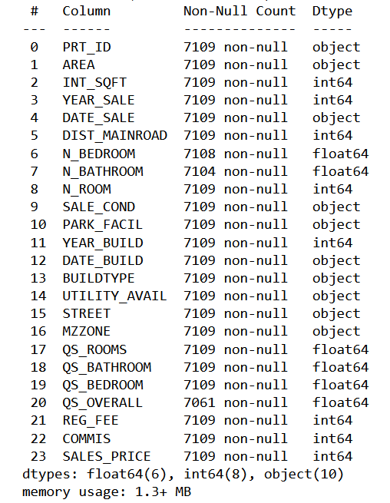
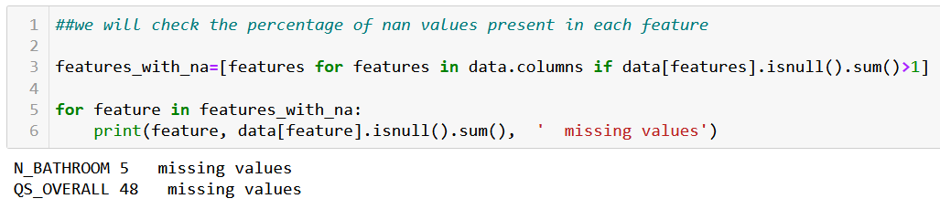
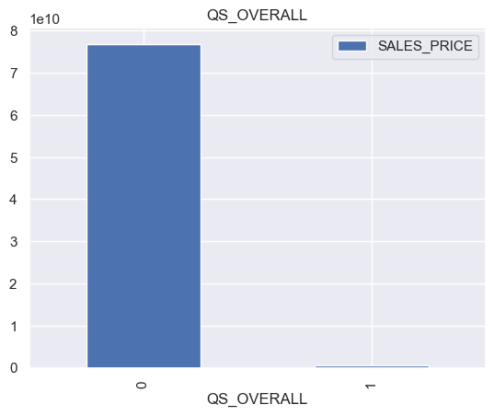
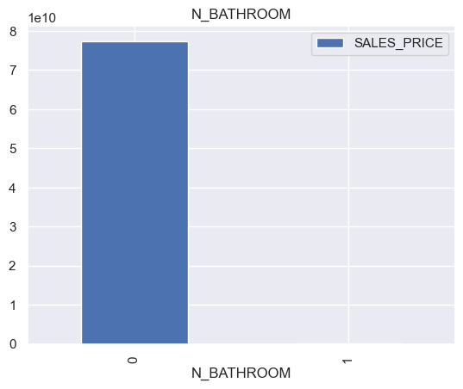
DATA CLEANING

Slide 11
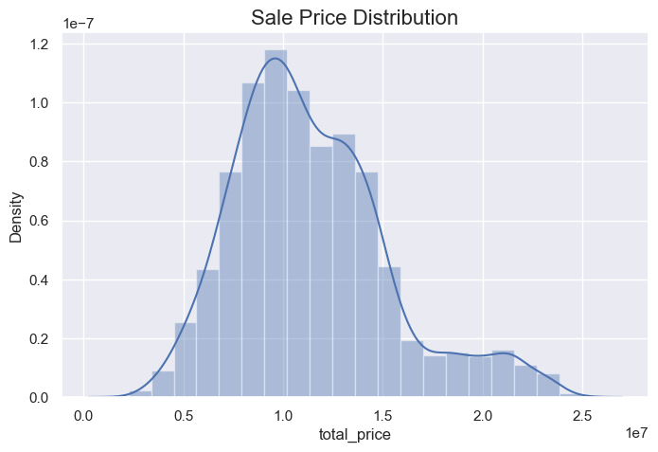
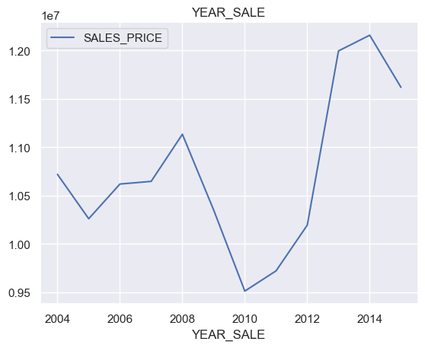
EXPLORATORY DATA ANALYSIS
My sale price normally distributed and right tail

Slide 12
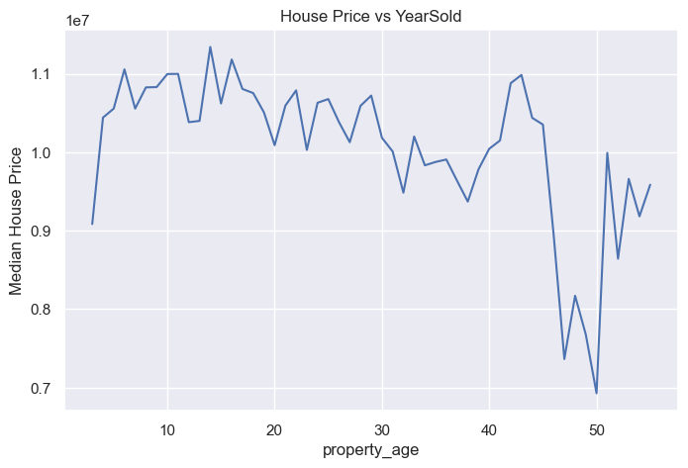
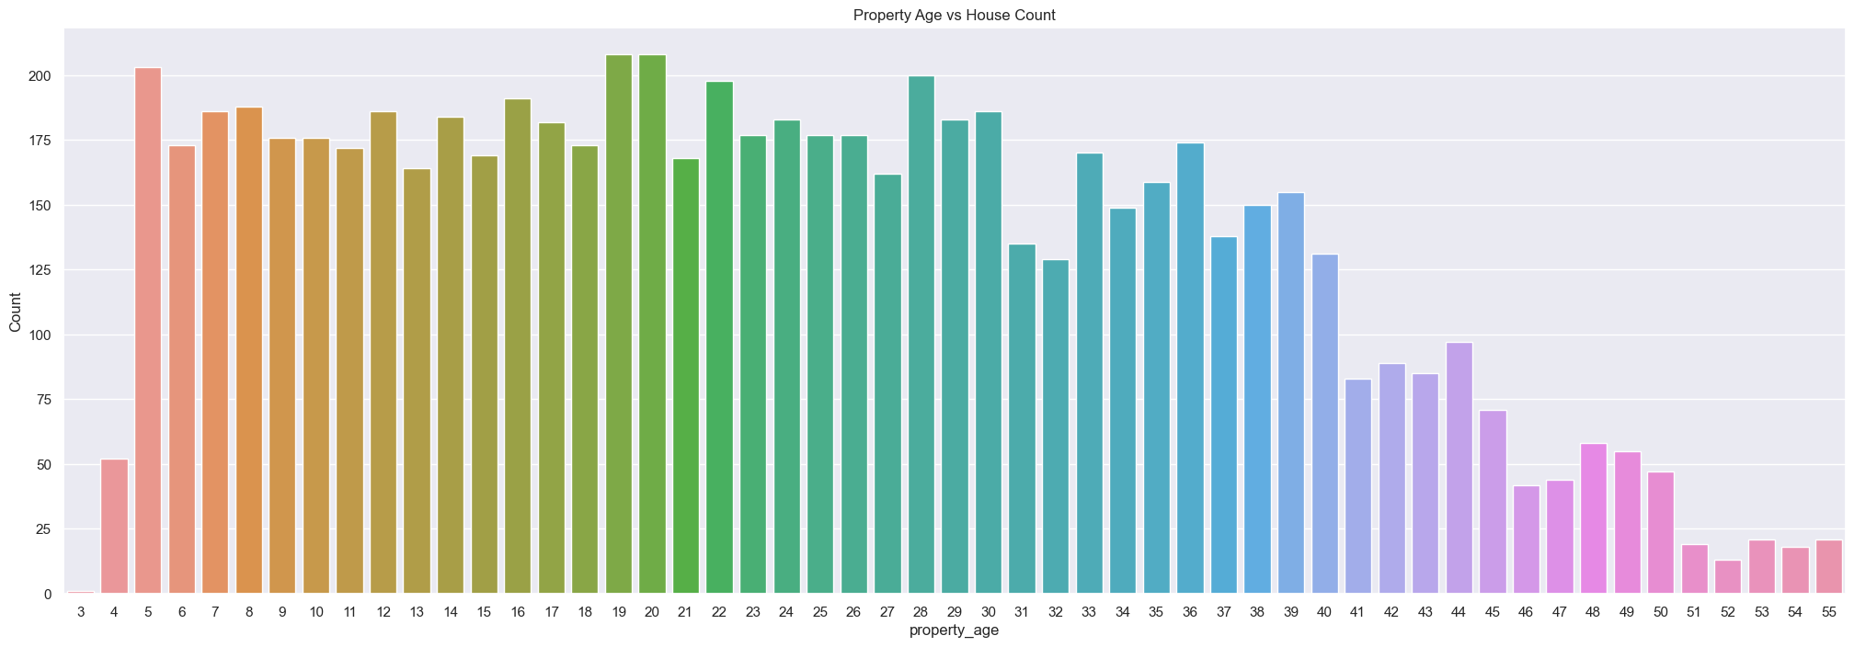
EXPLORATORY DATA ANALYSIS

Slide 13
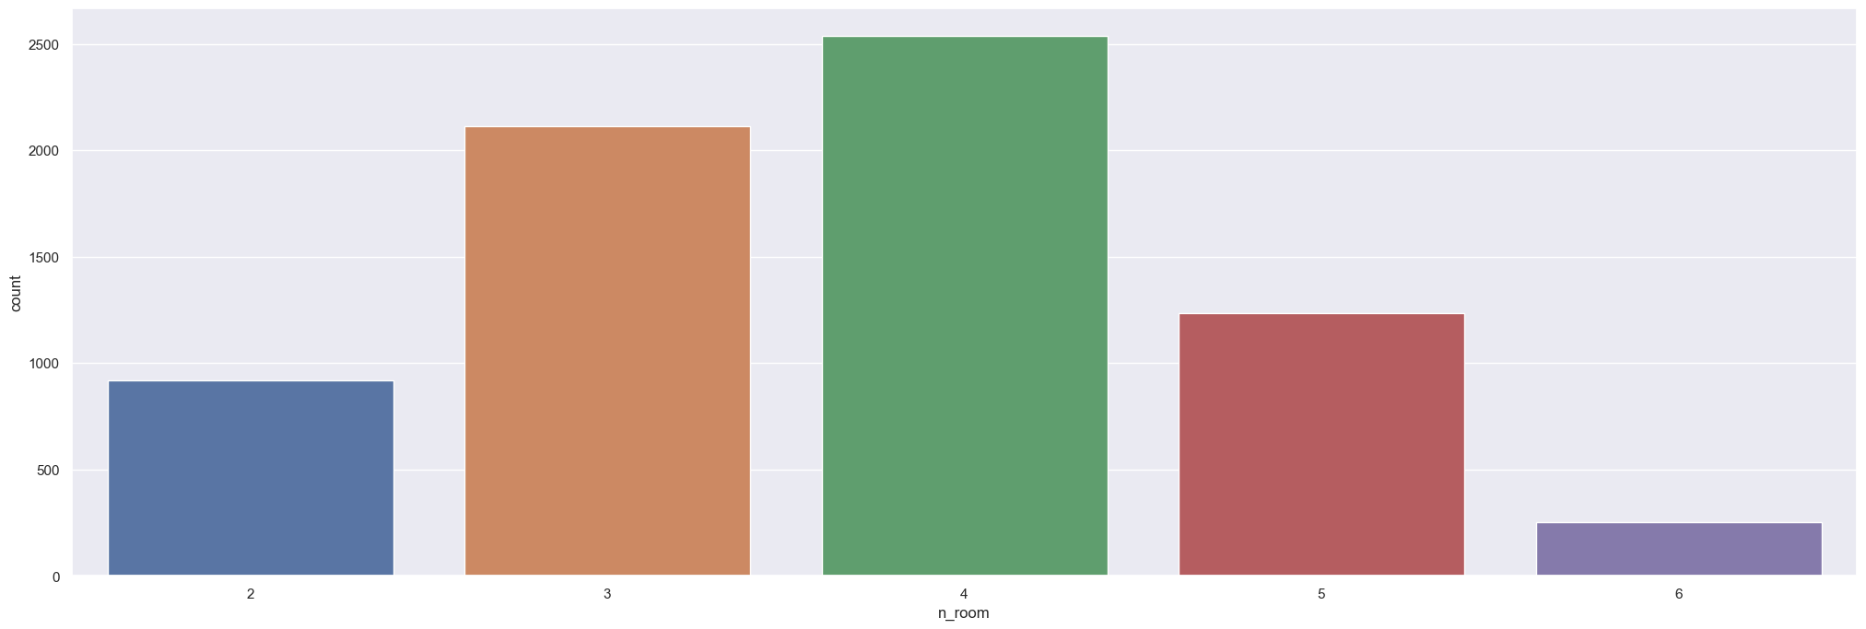
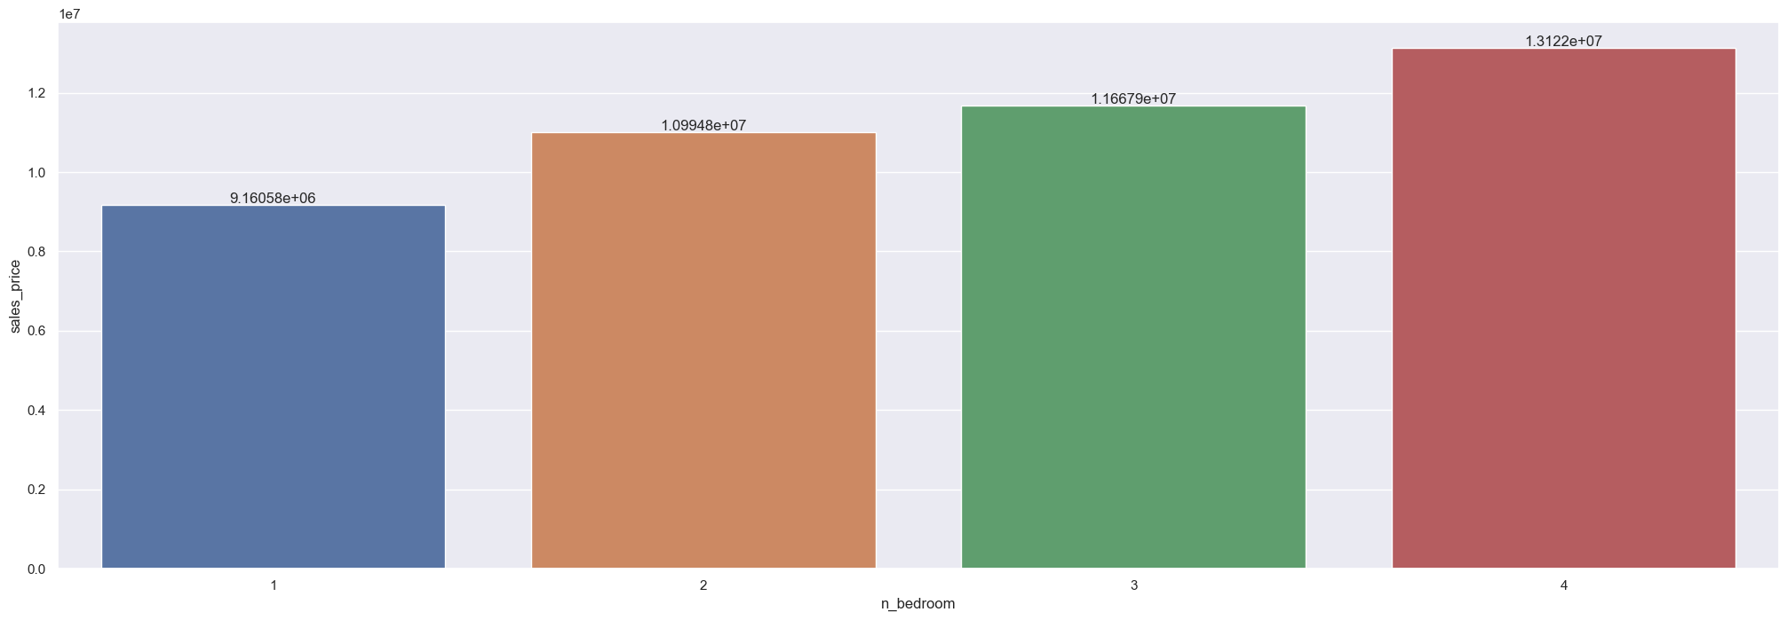
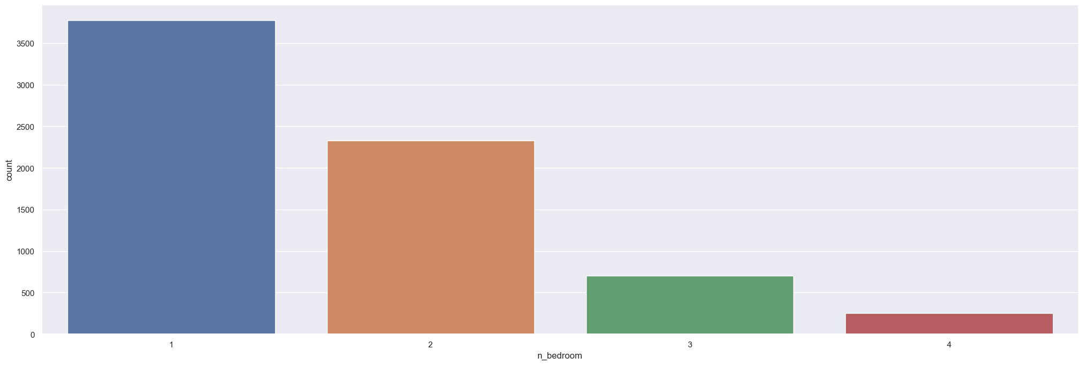
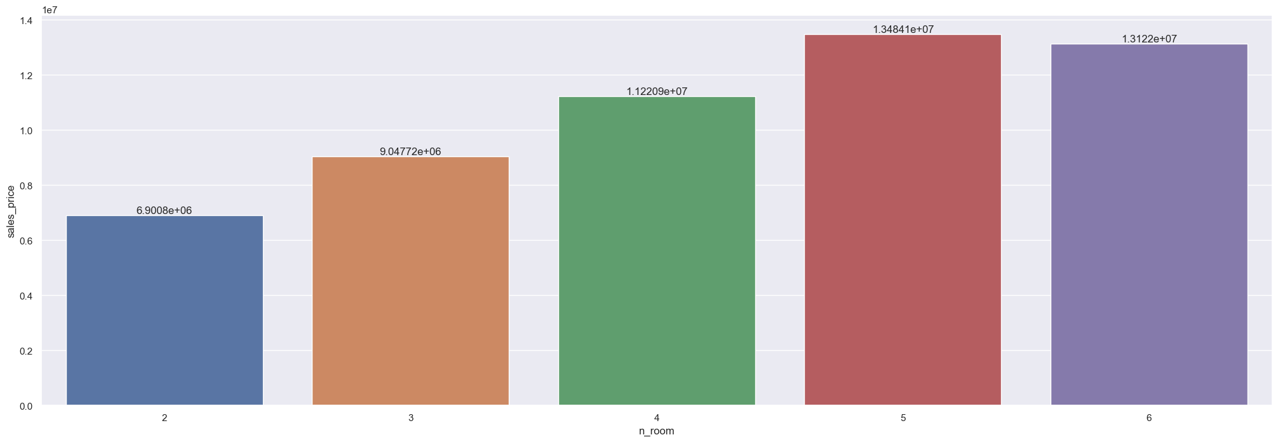

Slide 14
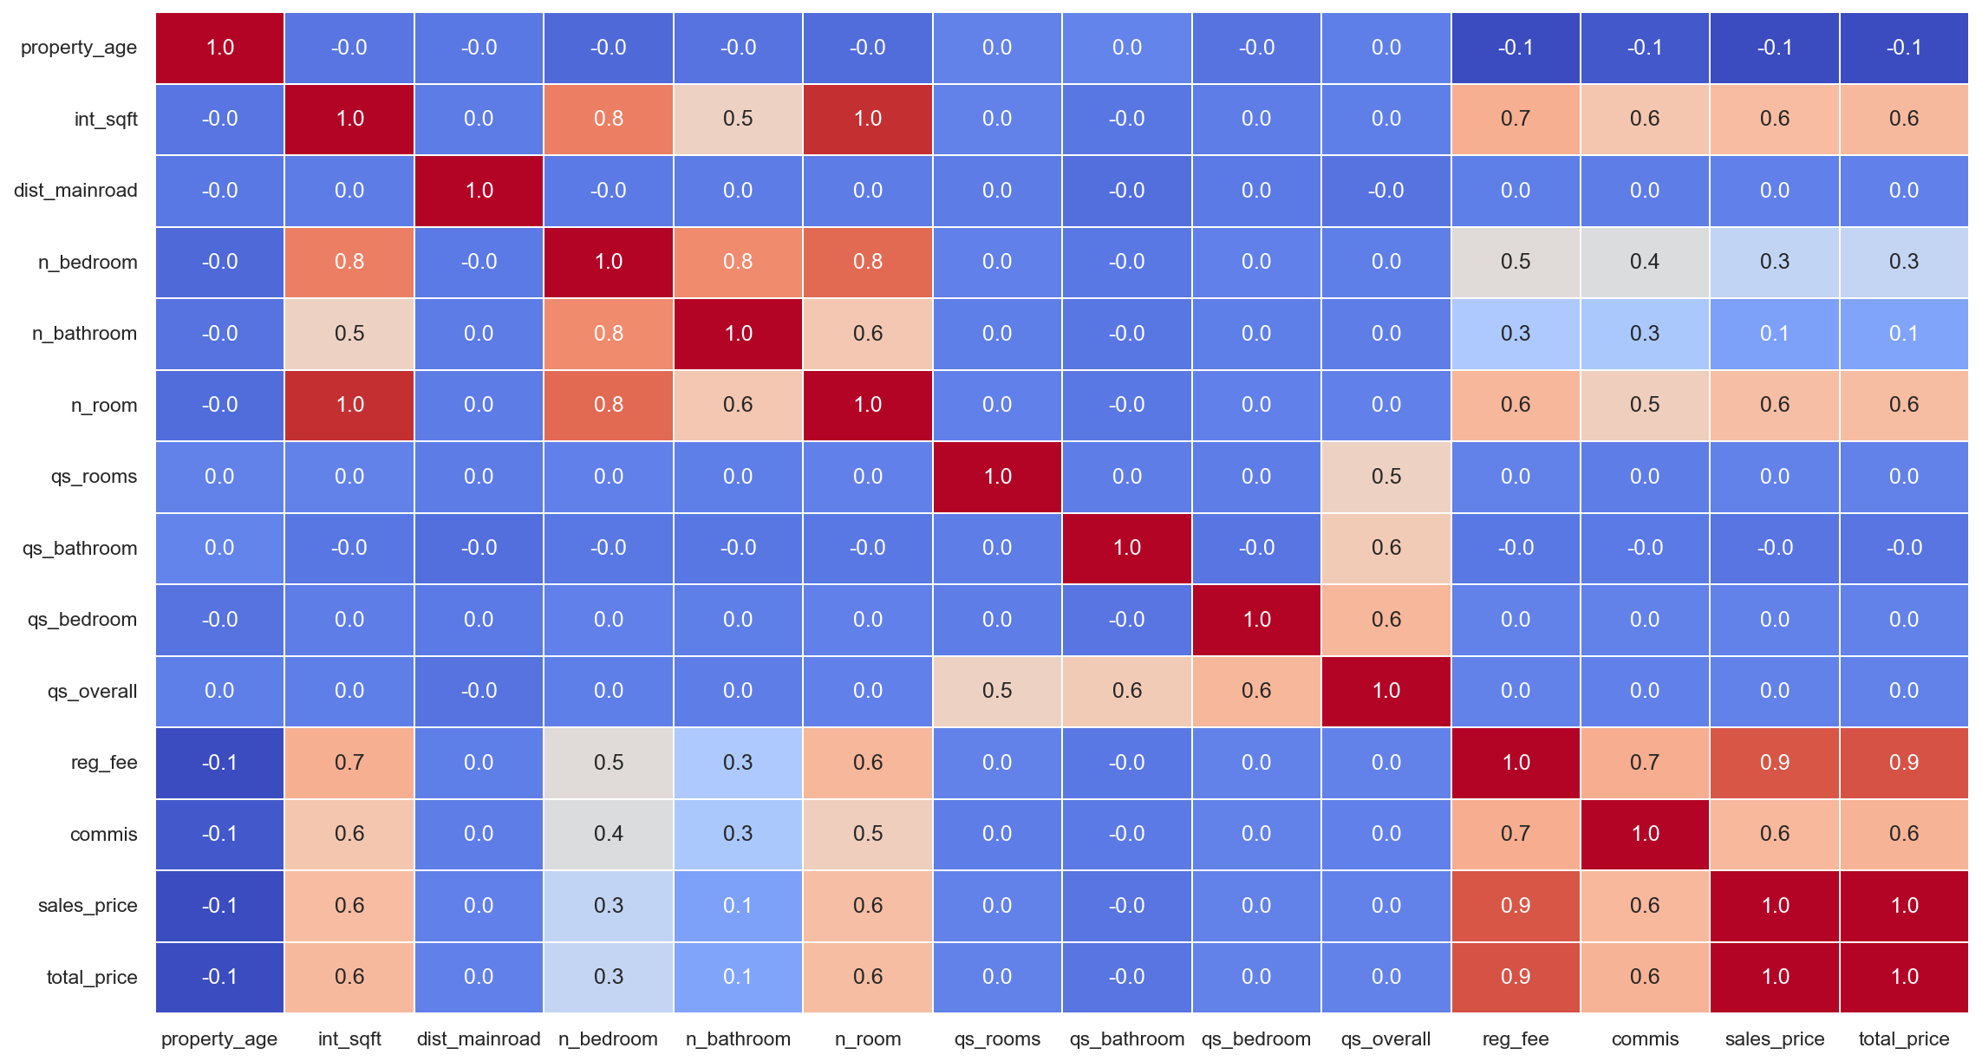
Heatmaps are very useful to find relations between two variables in a dataset.
numerical columns there are some correlation between target and features which are shown in reddish colour.

Slide 15
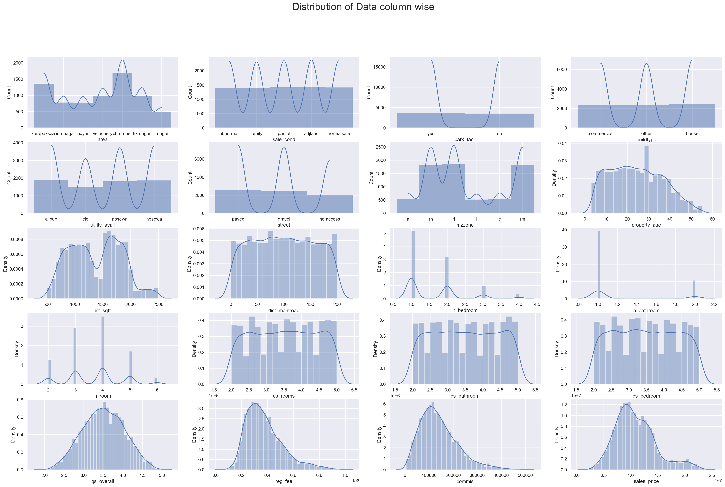
DISTRIBUTION OF DATA COLUMN WISE
distribution of data in all the columns are normally distributed in most of the cases and in very few column the data is very slightly skewed.

Slide 16
FEATURE ENGINEERING
Feature engineering is the process of extracting features from raw data using domain knowledge and data mining techniques. These characteristics can help machine learning algorithms perform better. Feature engineering can be thought of as applied machine learning.
In our dataset, dimensionality reduction techniques are used to remove rows that are insignificant in determining the house price.

Slide 17
NUMERICAL COLUMNS
Continues numerical variable Here we are plotting all our Continues numerical variable columns with total price of the house to figure out, is there any relation between Continues numerical variable features column and total sales.
In qs_overall we didn't find any relation so this feature will be of no use or very less us for us so we will drop it.
In int_sqft we find good relation so this feature will be very important for us so we will keep it.
In dist_mainroad we didn't find any relation so this feature will be of no use or very less us for us so we will drop it.
In property_age we find small relation so this feature will be useful for us so we will keep it.

Slide 18
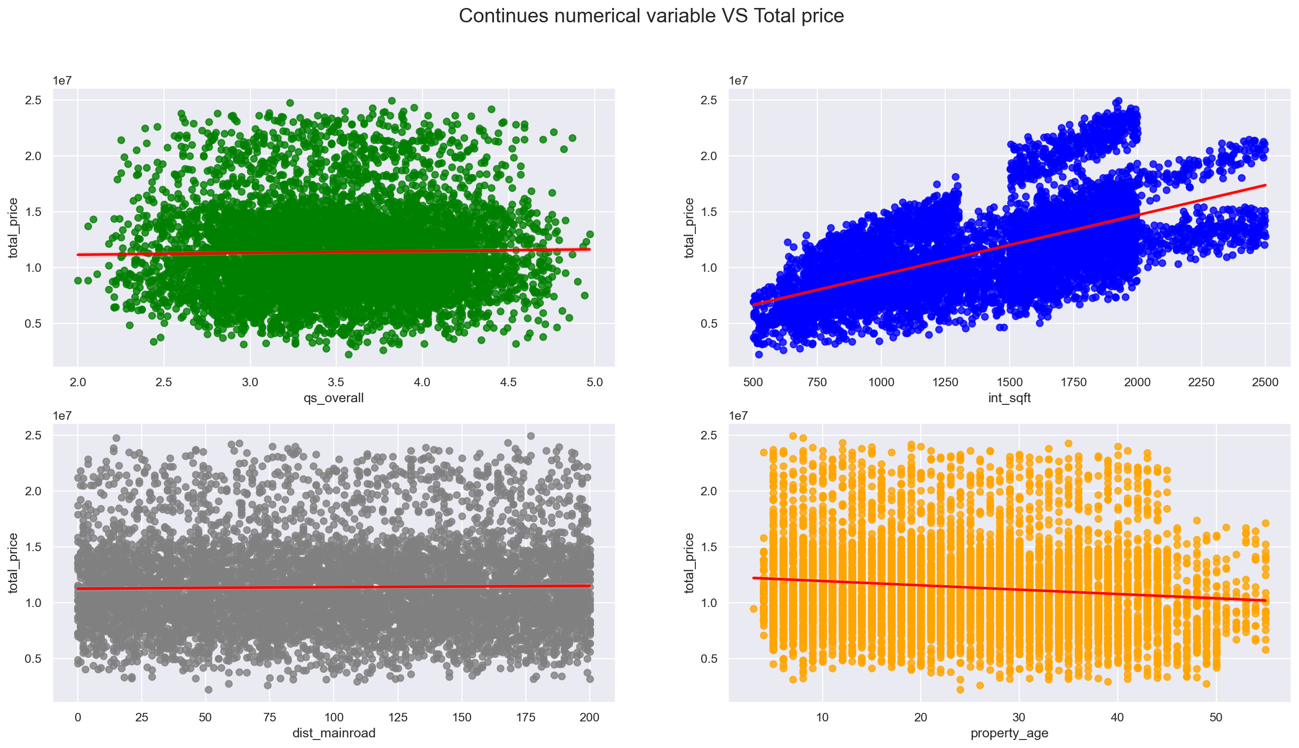
CONTINUES NUMERICAL VARIABLE VS TOTAL PRICE

Slide 19
DISCRETE NUMERICAL VARIABLE
In n_bedroom we find good relation so this feature will be very important for us so we will keep it.
In n_bathroom we find small relation so this feature will be useful for us so we will keep it.
In n_room we find good relation so this feature will be very important for us so we will keep it.
In qs_rooms we didn't find any relation so this feature will be of no use or very less us for us so we will drop it.
In qs_bathroom we didn't find any relation so this feature will be of no use or very less us for us so we will drop it.
In qs_bedroom we didn't find any relation so this feature will be of no use or very less us for us so we will drop it.

Slide 20
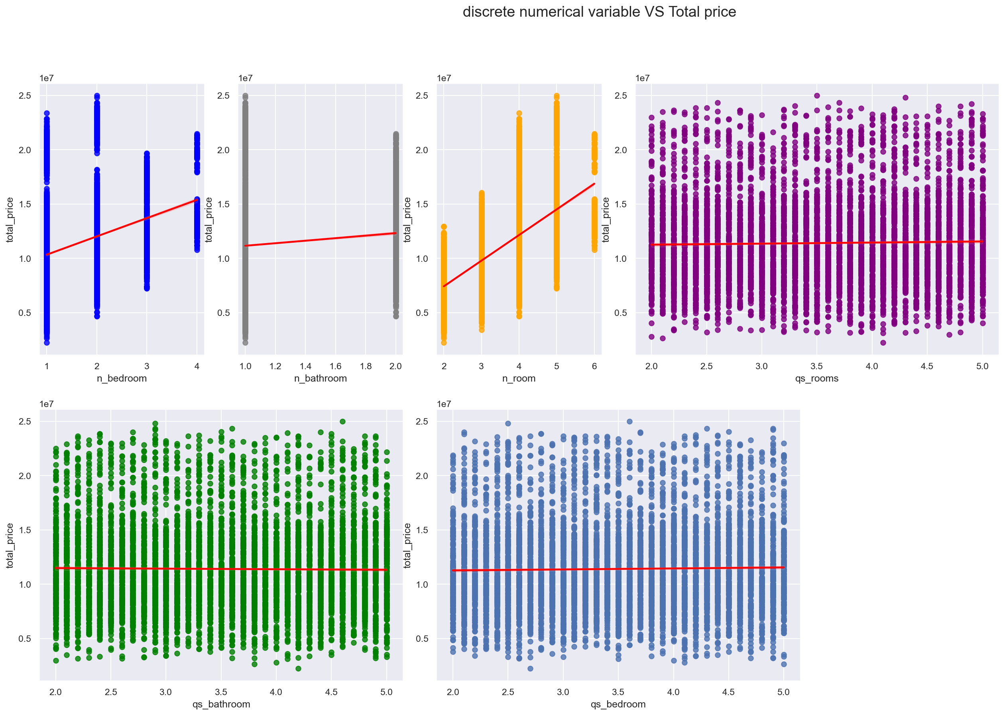
DISCRETE NUMERICAL VARIABLE VS TOTAL PRICE

Slide 21
COMMISSION AND REGISTRATION FEE COLUMNS
On top of all numerical columns we are given registration fee and commission columns on which sales price don't depends on but these two columns are completely depended on sales column value. That means after determining the sales price the commission and registration fee are paid.
Hence, these two columns don't directly contribute to determine the sale we can add value of these two column on sales column and try to predict total sale price. And at the end compare this result with only predicted sales price.

Slide 22
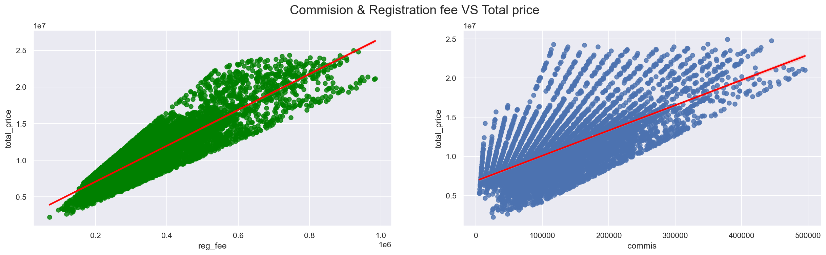
COMMISSION & REGISTRATION FEE VS TOTAL PRICE

Slide 23
CATEGORICAL COLUMNS
In area when we sort column in respect of total_price we find good relation linear ordinal relation in this categorical feature and it will be important for us so we will keep it and do label encoding by preserving the order.
In sale_cond when we sort column in respect of total_price we find good relation linear ordinal relation in this categorical feature and it will be important for us so we will keep it and do label encoding by preserving the order.
In mzzone when we sort column in respect of total_price we find good relation linear ordinal relation in this categorical feature and it will be important for us so we will keep it and do label encoding by preserving the order.
In utility_avain when we sort column in respect of total_price we find good relation linear ordinal relation in this categorical feature and it will be important for us so we will keep it and do label encoding by preserving the order.
In buildtype when we sort column in respect of total_price we didn't find linear relation in this categorical feature but it may beimportant for us so we will keep it and do OneHotEncoding on this column data.
In street when we sort column in respect of total_price we find good relation linear ordinal relation in this categorical feature and it will be important for us so we will keep it and do label encoding by preserving the order.
In park_facil when we sort column in respect of total_price we find good relation linear ordinal relation in this categorical feature and it will be important for us so we will keep it and do label encoding by preserving the order.

Slide 24
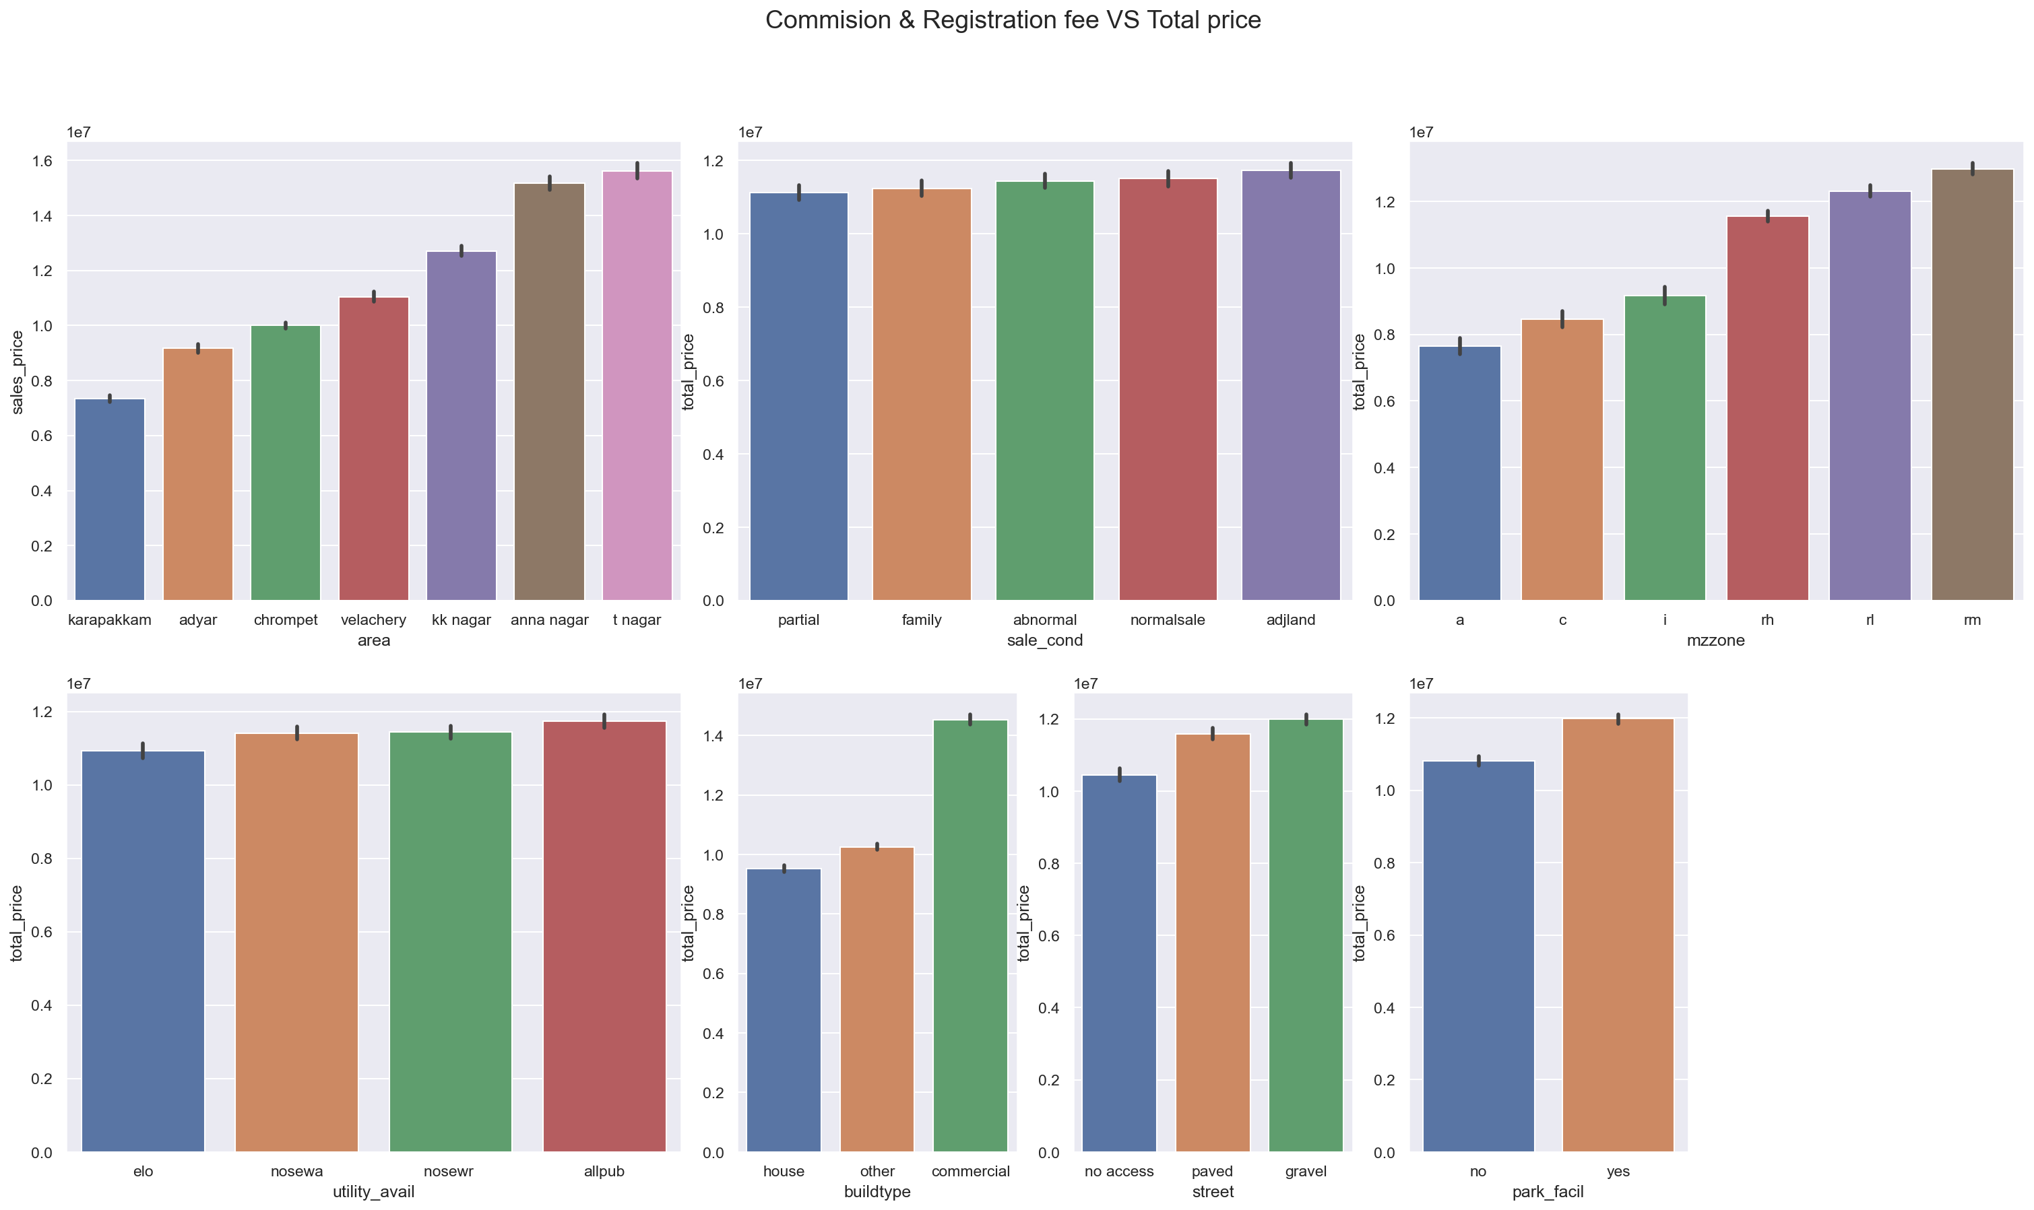
CATEGORICAL DATA VS TOTAL PRICE

Slide 25
OUTLIER DETECTION
An outlier is an observation that deviates from the overall pattern of a sample.
Outlier detection techniques are including Z-Score or Extreme Value Analysis, probabilistic and statistical modelling, information theory models, standard deviation, and so on.
To detect outliers in our dataset, we used simple domain knowledge of the real estate market.

Slide 26
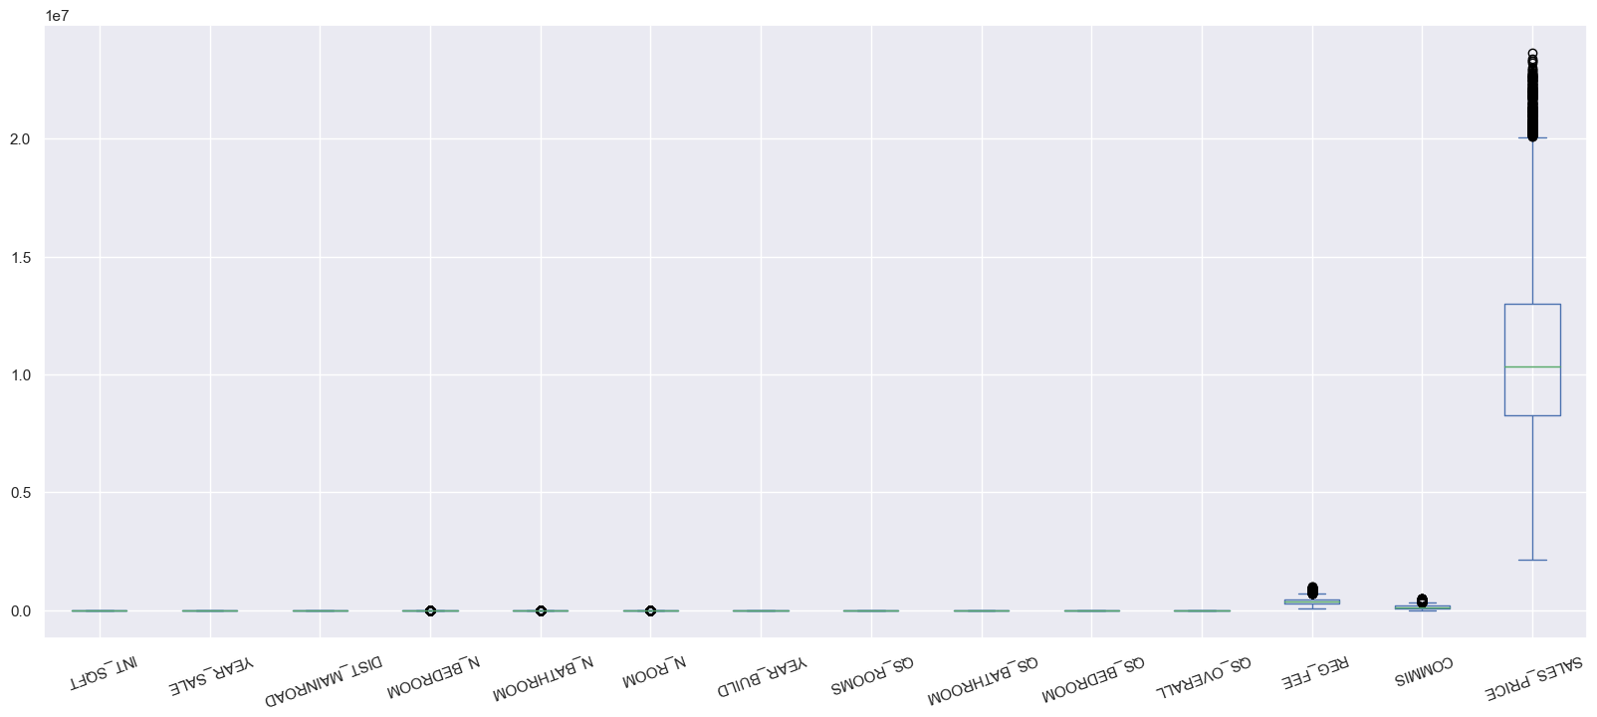
OUTLIER DETECTION

Slide 27
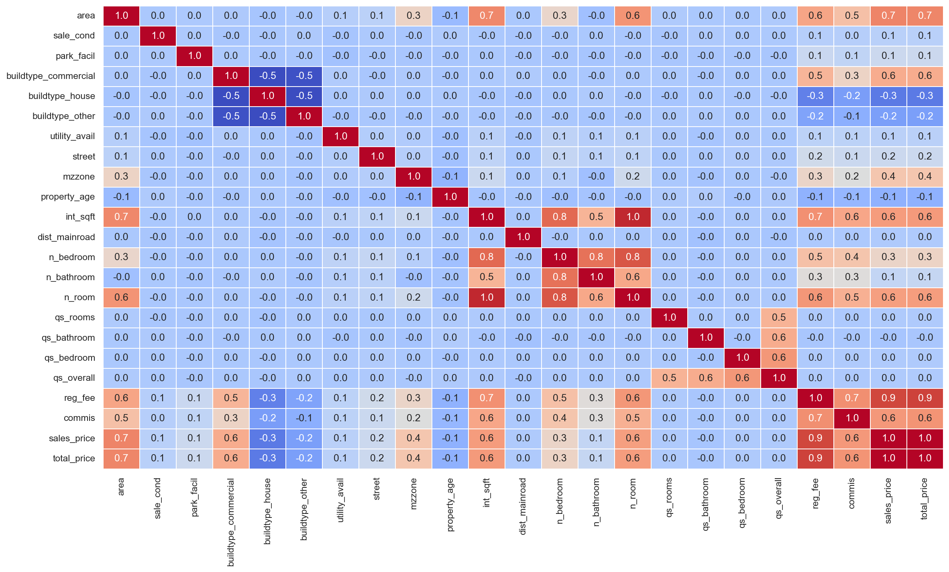
CATEGORICAL COLUMNS VS TARGET

Slide 28
MODEL EVALUATION
Modelling is the process of training a machine learning algorithm to predict labels based on features.
We have 80% training data 20% testing data
We used Linear Regression, Gradient Boosting Regression, XGB Regression, Random Forest Regression, and the K Neighbours Regression algorithm to train and test the model.
Our model has a 99% accuracy rate, which is quite good.

Slide 29
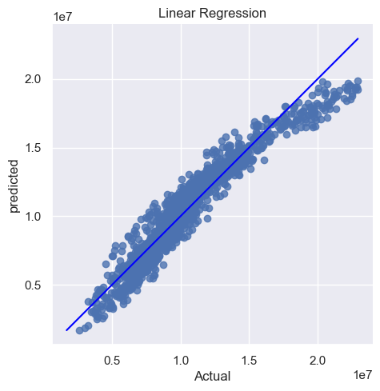
LINEAR REGRESSION
R2 Score : 0.920545
Mean Squared Error : 1.127599
Adjusted R2 Score : 0.920362

Slide 30

RIDGE REGRESSION
R2 Score : 0.920554
Mean Squared Error : 1.127484
Adjusted R2 Score : 0.920370

Slide 31

LASSO REGRESSION
R2 Score : 0.920545
Mean Squared Error : 1.127599
Adjusted R2 Score : 0.920362

Slide 32
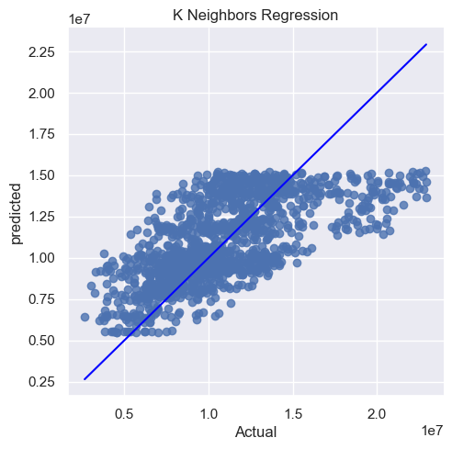
K NEAREST NEIGHBOUR
R2 Score : 0.432962
Mean Squared Error : 8.047259
Adjusted R2 Score : 0.431653

Slide 33
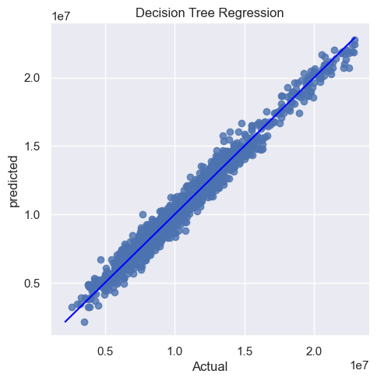
DECISION TREE
R2 Score : 0.974923
Mean Squared Error : 3.558925
Adjusted R2 Score : 0.974865

Slide 34
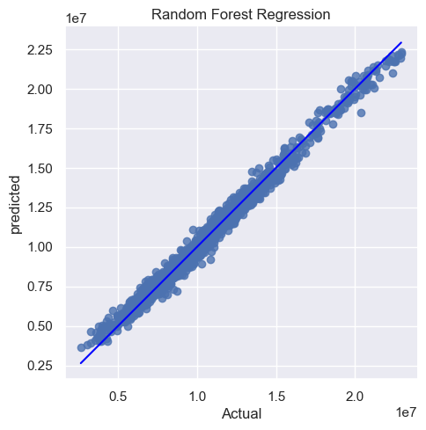
RANDOM FOREST
R2 Score : 0.987564
Mean Squared Error : 1.764950
Adjusted R2 Score : 0.987535

Slide 35

GRADIENT BOOSTING
R2 Score : 0.993724
Mean Squared Error : 8.906226
Adjusted R2 Score : 0.993710

Slide 36
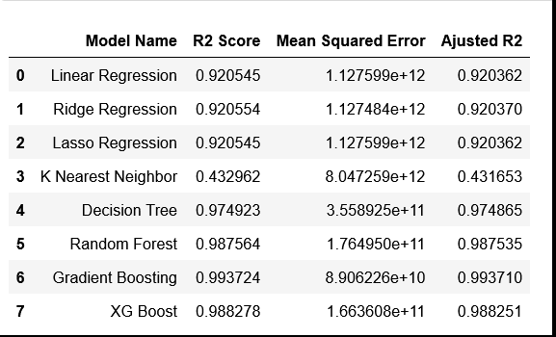
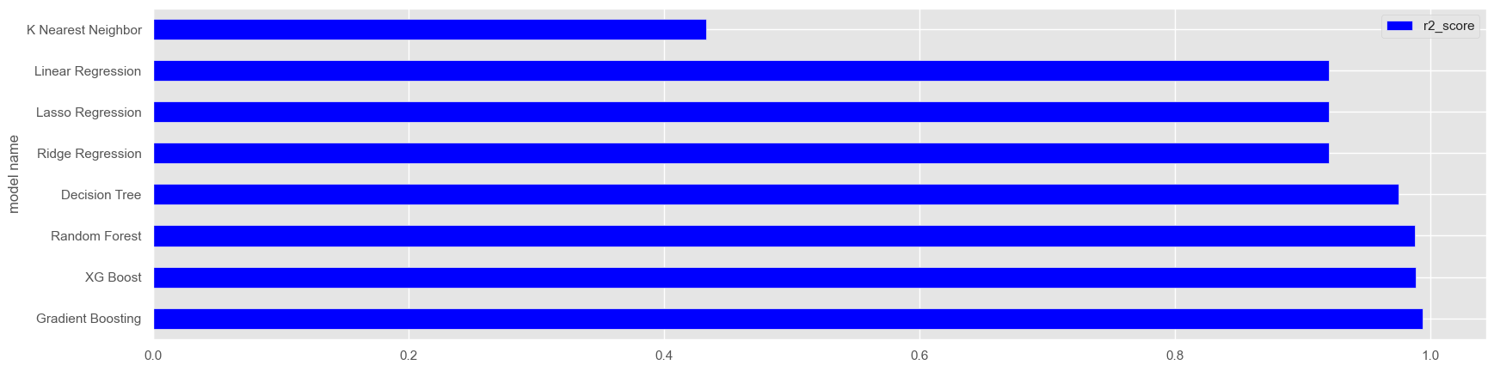
IMPLEMENTATION

Slide 37
K-FOLD CROSS VALIDATION
Cross-validation is a statistical method for estimating machine learning model skill.
It is commonly used in applied machine learning to compare and select a model for a given predictive modelling problem because it is simple to understand, simple to implement, and produces skill estimates with lower bias than other methods.
After applying the k-fold cross-validation method to our final dataset, we find that our accuracy rate is always greater than 98%.

Slide 38
RESULT/OUTPUT
We developed a function to forecast house prices.
Our function will be "predict price(location, sqft, bath, bhk)".
When we enter the values into our function, it will calculate the house price for us.

Slide 39
Drawback
It doesn’t predict future prices of the houses mentioned by the customer.
Due to this, the risk in investment in an apartment or an area increases considerably.
To minimize this error, customers tend to hire an agent which again increases the cost of the process.
This leads to the modification and development of the existing system.

Slide 40
THANK YOU

